Slide 1
Neuron Sandbox - Overview and Implementation
The purpose of this document is to provide best practices and show how to use Neuron Sandbox in conjunction with the worksheet for Module 3.5b.
The problems and neuron illustrations that we provide are taken directly from Neuron Sandbox.
We have found the chart to be the most effective way to have students build confidence and understanding of the content provided in Neuron Sandbox.
If you would like a more thorough explanation of the content that is being taught in this lesson, please see the slideshow for 3.5b.
Notes:
LINK WHEN PUBLISHED

Slide 2
Accessing Neuron Sandbox
Neuron Sandbox runs in any web browser. Access it for free at:
https://www.cs.cmu.edu/~dst/NeuronSandbox
Neuron Sandbox is an open source project published on GitHub:
https://github.com/touretzkyds/NeuronSandbox
Authors: Angela Chen, Neel Pawar, and David S. Touretzky, Carnegie Mellon

Slide 3
Vocabulary
Neuron - A computing unit that takes numbers as input and produces a number as output
Weights - Numbers that are used to scale the inputs to a neuron
Activation value - The sum of the weighted inputs to a neuron
Threshold - A number that the activation value has to exceed in order for the neuron to output a 1
Boolean function - A function that takes true and false values as its inputs and outputs either true or false, usually represented as 1 or 0.
Truth table - A table of all the possible inputs to a boolean function and the output for each input

Slide 4
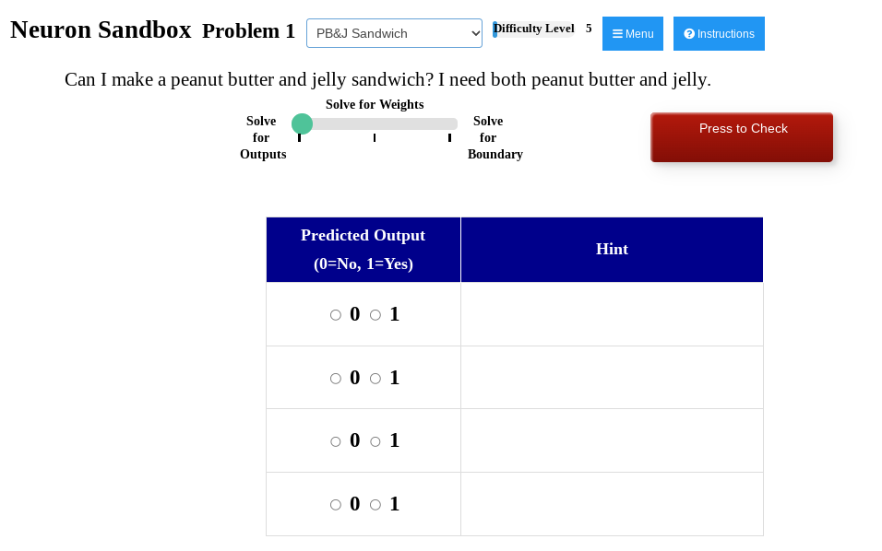
Step 1: Have Students Solve for Outputs in Neuron Sandbox
This is so students understand what the outputs of the problem should be.

Slide 5
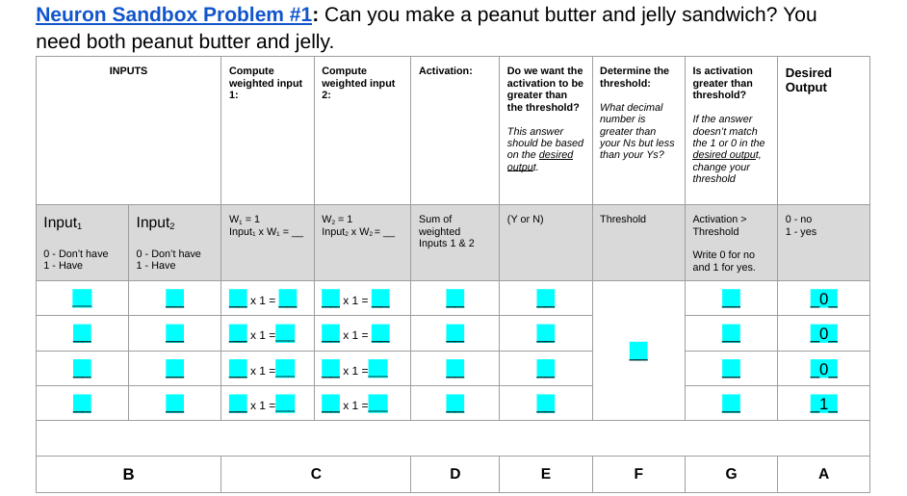
Step 2: Put the outputs you just found onto the chart (Column A)

Slide 6
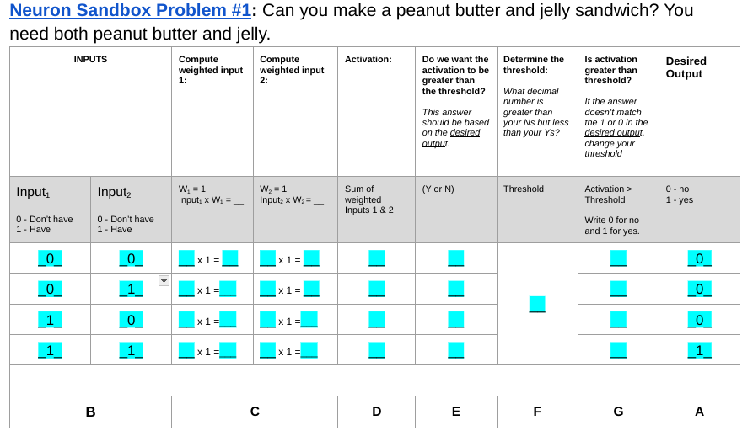
Step 2: Put the inputs from Neuron Sandbox into the chart (Column B)

Slide 7
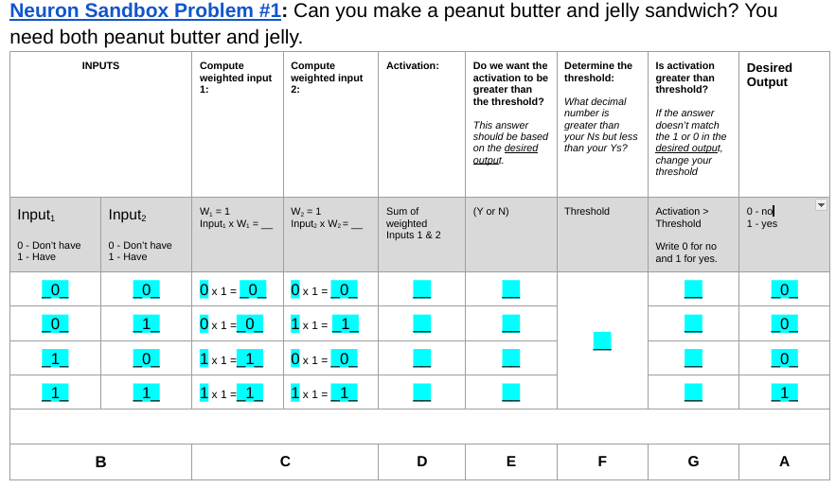
Step 3: Compute the Weights (Column C)

Slide 8
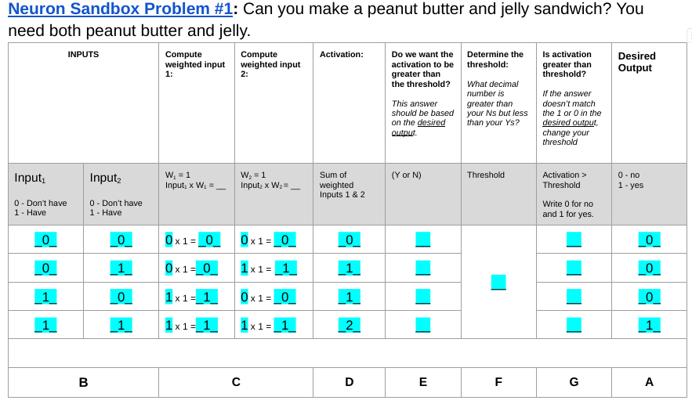
Step 4: Sum the weighted inputs to calculate Activation (Column D)

Slide 9
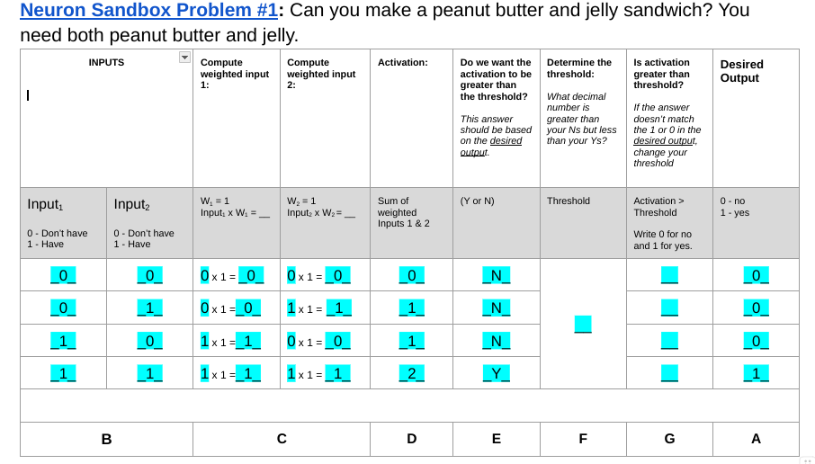
Step 5: Analyse if you want the activation to be greater than the threshold (Column E)

Slide 10
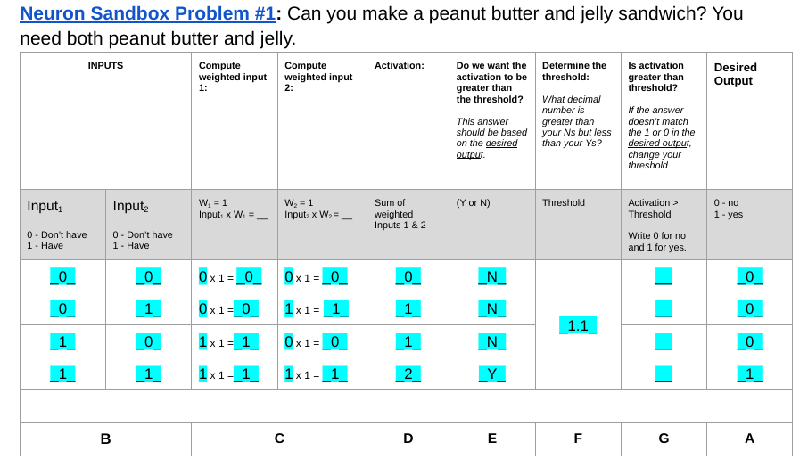
Step 6: Determine the threshold (Column F)

Slide 11
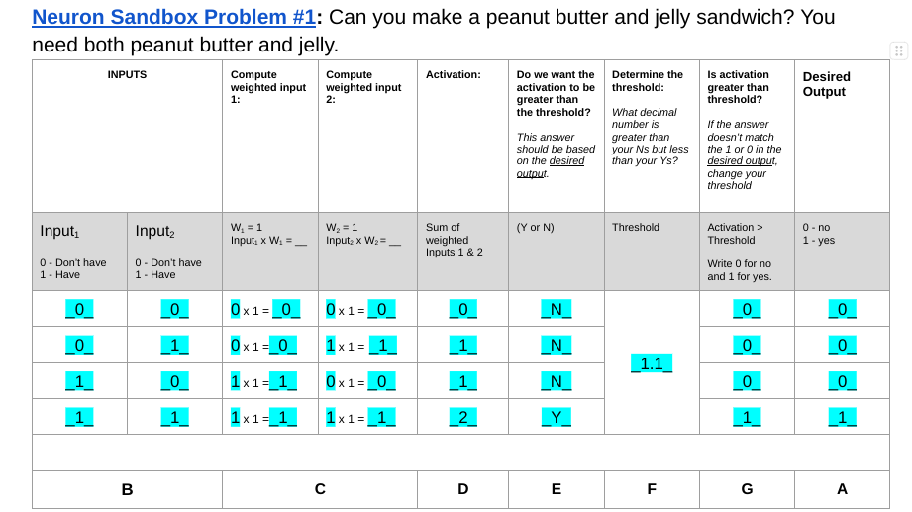
Step 7: Check your answer by seeing if the activation is greater than your threshold. (Column G)

Slide 12
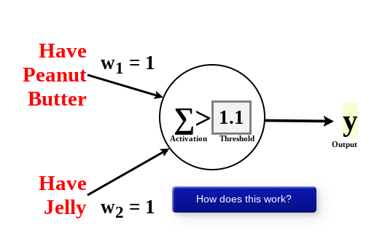
Step 8: Return to Neuron Sandbox and input your answer!

Slide 13
Completing additional problems!
For additional problems provided in neron sandbox, students can use a blank chart to complete their work.
For problems that need you to solve for the weights, just follow the letters at the bottom of the chart to work backwards.

Slide 14
Next Steps!
Have students view CNN Explainer
Explain that to examine one pixel of an image requires one neuron to analyze.
This means that the starting image that is 64 * 64 pixel requires 4,096 neurons!
Remind students that all of their work has been to just create one!
To determine if a picture of espresso is a picture of espresso, it requires over 73,976 neurons!

